Slide 1
This presentation
may not be posted on any web site
at the request of the contributing authors who have shared their work with this author.
See additional information on Rules For Use and Disclaimers on slide 56 at the end of this presentation.
Revisions 25 July 2015

Slide 2
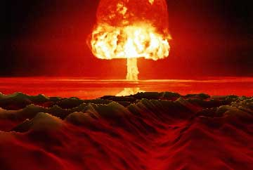
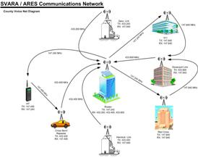
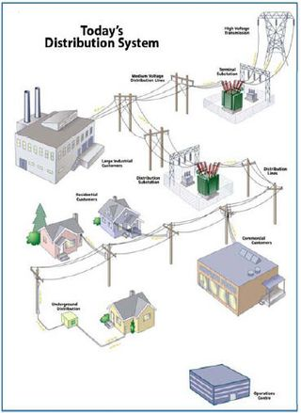
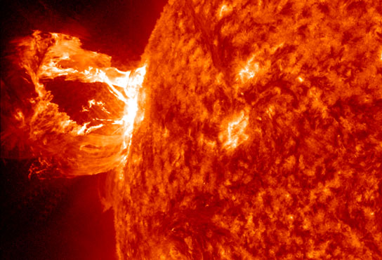
What If a S0lar or Nuclear EMP happens?
Is it the end of our Electronic World?

Slide 3
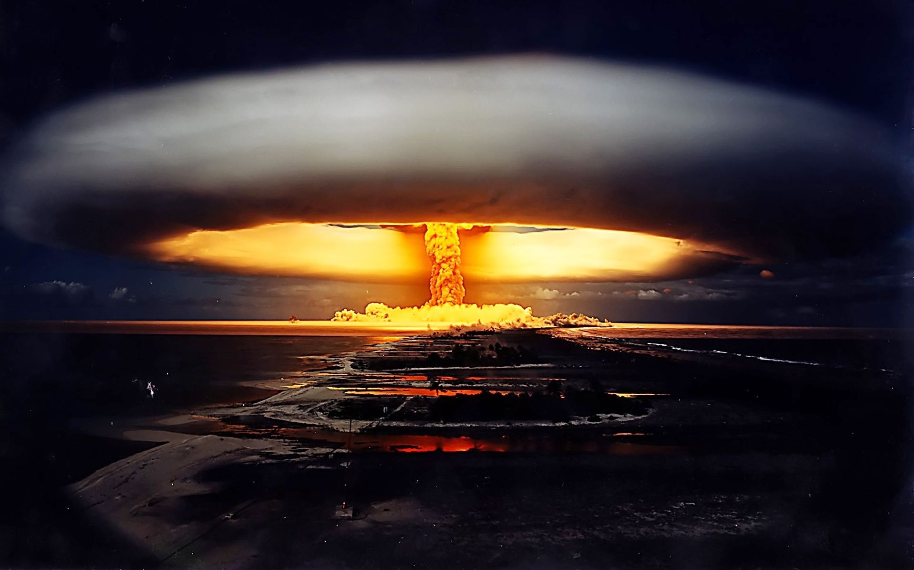

The Power Grid and
Electronics and Communication Equipment are vulnerable to Electro Magnetic Pulse (EMP)
From a Mass Coronal Ejection (MCE) or Nuclear Detonation,
Developed by Jack Tiley AD7FO
Based on Presentation by Bart Lee K6VK For Pacificon 2011 Copyright by Bart Lee 2011 (with permission) . Additional information from copyrighted material in a Nov 2009 QST article by H. Robert Schroeder N2HX (With Permission) Paper by Jerry Emanuelson Web reference at end of presentation and other sources.

Slide 4
Monocultures
Monocultures occur when society becomes dependent on a single crop, natural resource, network, technology, etc.
We are at risk when one of these monocultures we are totally dependent on fails and we have no, or insufficient back up capability

Slide 5
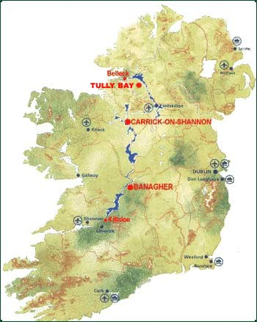
The Irish Agriculture Monoculture
The Irish Potato Famine was caused by a crop monoculture where the potato was the main food crop. When the potato crops failed they had no alternative crop and many died.

Slide 6
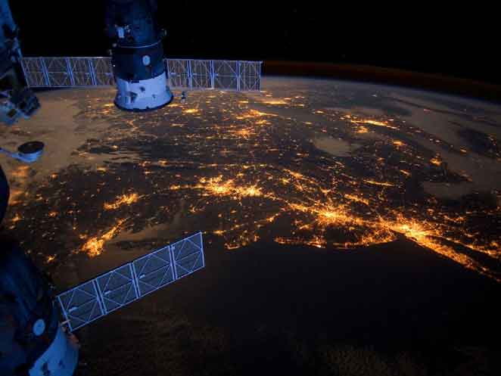
Our Electricity Monoculture
Today we are dependent on electricity
in most developed countries

Slide 7
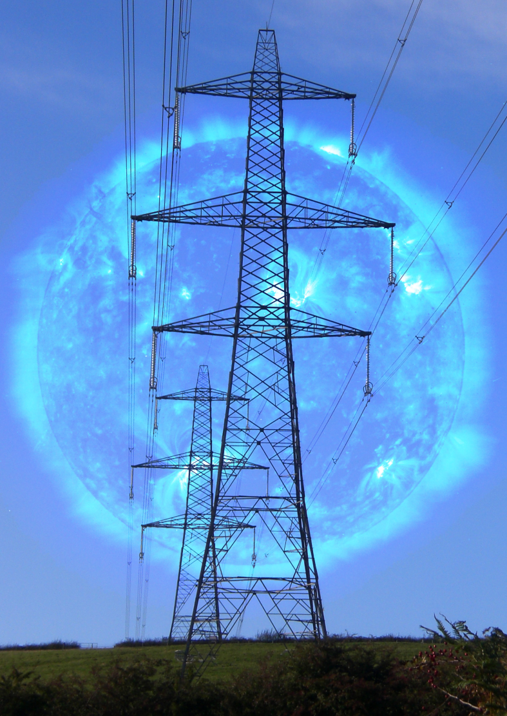
Power Distribution Networks
During a MCE or Nuclear EMP Event our power distribution system would look like a giant antenna farm

Slide 8
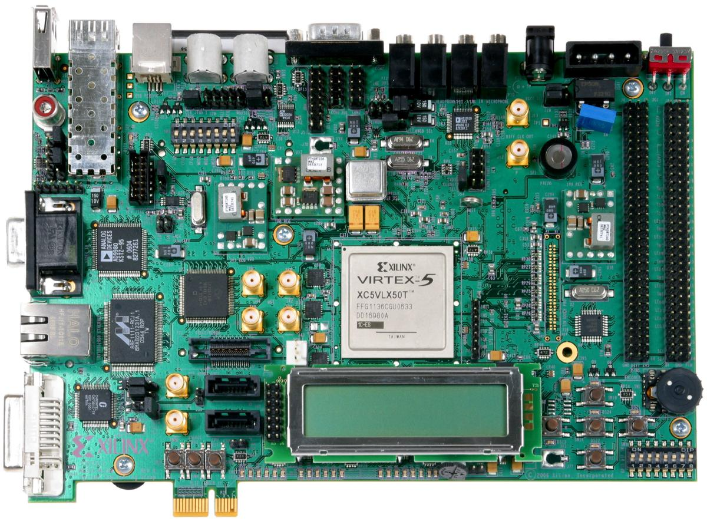
Modern Electronic Devices
Typical modern electronics circuits contain many semiconductor and other fragile components.

Slide 9
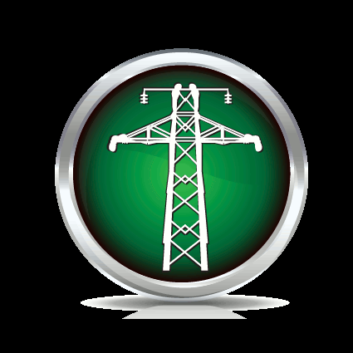
Our Civilization Wide Monoculture
Most everything we do now relies on Electrical, Electronic and Digital technology.
Electricity is the foundation of our Industry, Logistics, Operations, Finance and Communications.
Public, Truck, Rail, Automobile transportation all use electronic technology and solid-state devices.

Slide 10
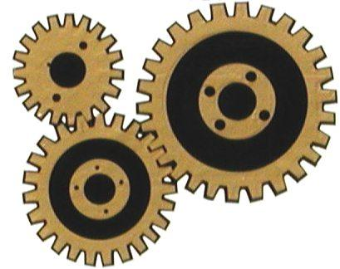
Our Civilization Wide Monoculture
(continued)
Everything is running smoothly today.
So what could possibly go wrong?

Slide 11
Mass Coronal Ejections and EMP
The Sun Could have a Bad Day

Slide 12
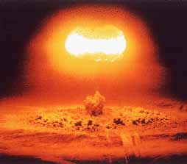
Nuclear Explosion and EMP
Mankind Could Also Have a Bad Day

Slide 13
Two Threats: Nature and Man
Electro Magnetic Pulse (EMP) can come from the sun by way of a Mass Coronal Ejection (giant Solar Flare) referred to as a MCE.
Electro Magnetic Pulse (EMP) can also come from a high altitude Atomic Device detonation.
Both events are of unknown (Low?) likelihood.
Either of these events could significantly alter our way of life because of our Electrical/Electronic dependence.

Slide 14
Nuclear EMP
Nuclear EMP is actually an electromagnetic multi-pulse. The EMP is usually described in terms of 3 components.
TheE1 pulse is a very fast (nanosecond) pulse that can induce very high voltages in equipment and along electrical wiring and cables. E1 is the component that destroys computers and communications equipment and is too fast for ordinary surge and lightning protectors.

Slide 15
The E1 Component
The E1 component of the pulse is the most commonly-discussed component.
The gamma rays from a nuclear detonation in space can travel great distances. When these gamma rays hit the upper atmosphere, they knock out electrons from atoms in the upper atmosphere, which travel in a generally downward direction.
This forms what is essentially an extremely large coherent vertical burst of electrical current in the upper atmosphere over the entire affected area.

Slide 16
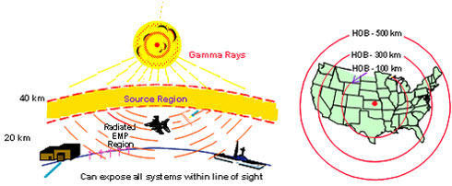
The E1 Component (continued)

Slide 17
The E1 Component (continued)
This current interacts with the Earth's magnetic field to produce a strong electromagnetic pulse, which originates a few miles overhead, even though the nuclear detonation point may be a thousand miles away or more. Since the E1 pulse is generated locally, even though the original gamma ray energy source may be in space at a great distance away, the pulse can cover extremely large areas, and with an extremely large EMP field over the entire affected area.

Slide 18
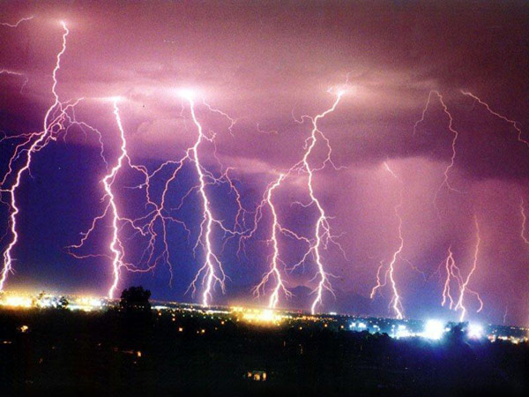
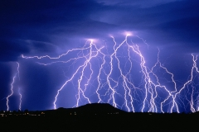
The E2 Component
The E2component of the pulse is the easiest to protect against, and has similarities in strength and timing to the electrical pulses produced by lightning.

Slide 19
The E3 Component
The E3 pulse is very different from the E1 and E2 pulses from an EMP. The E3 component of the pulse is a very slow pulse, lasting tens to hundreds of seconds, that is caused by the nuclear detonation heaving the Earth's magnetic field out of the way, followed by the restoration of the magnetic field to its natural place.
The E3 component has similarities to a geomagnetic storm caused by a very severe solar flare.

Slide 20
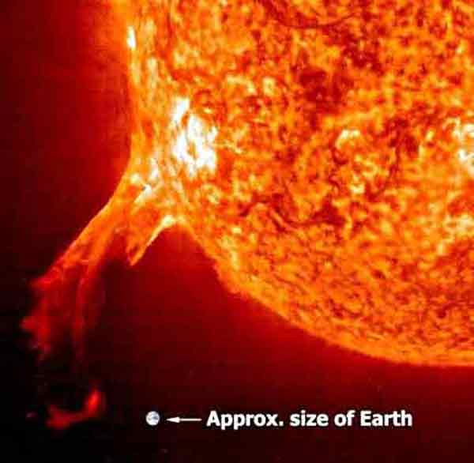
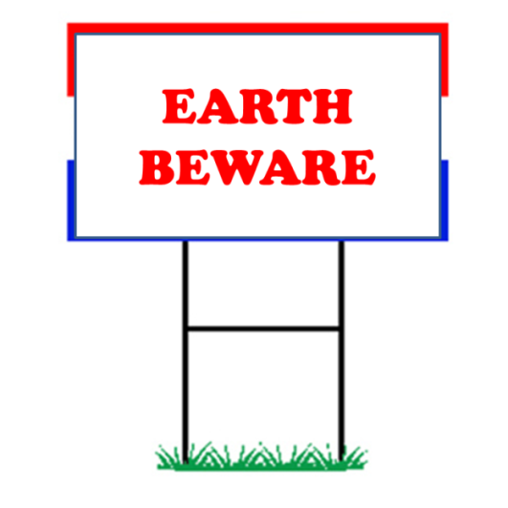
What does a solar flare look like?
Solar Flares can and do happen.
Increasing solar storms
and other activity on the suns surface put the world’s power grids and everything electronic at risk.

Slide 21
A Recent Coronal Mass Ejection
There is a good article and photos in the June 2012 National Geographic Magazine.
It describes some of the past major solar MCE events
There have been major solar storms reported recently.

Slide 22
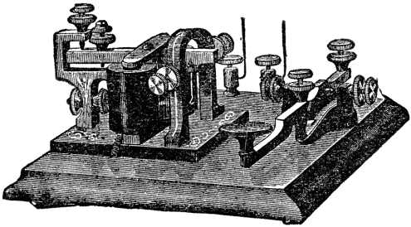
Solar Storms Happened in the Past
On September 1st and 2nd, 1859, “Earth’s inhabitants experienced the greatest solar storm in recorded history” known as the “Carrington Event”.
The electrical grid was in it’s infancy, consisting mainly of a few telegraph wires in larger cities.
This Solar Storm short circuited the wires in the telegraph system and caused fires.

Slide 23
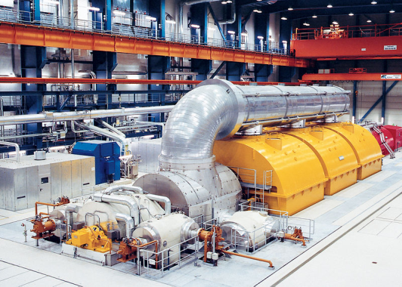
Solar Storms are Happening Today
In 1989 and 1994, solar storms knocked out communication satellites, shut down power plants and disrupted the electrical grid.
These were minor solar flares. Imagine if a solar storm the size of 1859 Carrington Event struck our modern society?

Slide 24
EMP From Nuclear Blast
According to the Washington (DC) Department of Health, Office of Radiation Protection, “A 1.4 Megaton nuclear bomb detonated about 250 miles above Kansas would destroy most of the electronics that were not protected in the entire Continental United States”.
how would the mass population handle a prolonged event with no communication and no electricity?
As the Commission noted, “our society is utterly dependent on our electrical grid for everything”.

Slide 25
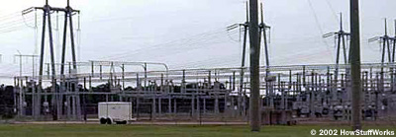
CME Consequences
Minor MCE Events have taken out power grids, e.g. Quebec Province in 1989.
A major MCE event could take down most, maybe all, of the US power grid by destroying the power infrastructure. It would take years to procure and replace transformers,
substation components etc.

Slide 26
EMP Consequences
An Atomic weapon detonated above the ionosphere generates ionizing radiation that creates RF emissions from ionospheric electrons.
The burst of radio frequency energy is strongest between 1 MHz and 10 MHz and can extend to 100 MHz.
This EMP is strong enough to destroy all electronics connected to a wire. (antenna or not, like power cords, interconnect cabling, etc.)

Slide 27
What Could Fail In A Major Event?
IF the national power grid fails, not enough reserve materials exists to bring it back up quickly.
Communication systems will fail (cell and land line phones, the internet, GPS Navigation. Etc.).
Transportation comes to a halt. Modern vehicles with computer controls stop operating.
Without transportation there is cessation of material and goods flow. (fuel, food, medicine, materials) to bring back the infrastructure.

Slide 28
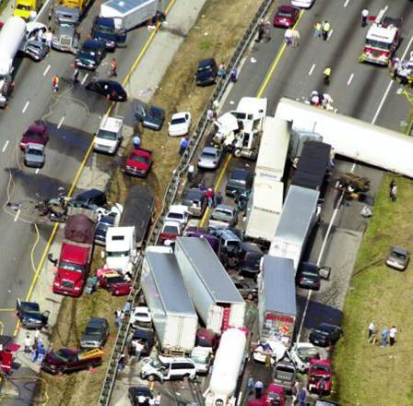
What Could Fail In A Major Event?
(Continued)
Vehicles on the road will stop suddenly and may result in many accidents.
Traffic control systems and traffic lights will cease operating.
Aircraft in flight are essentially
in a “Faraday Shield” protecting
what’s inside the aircraft.
Un-protected military vehicles
may become disabled.

Slide 29
What could fail in a major EMP Event?
(Continued)
Fuel for the older technology vehicles that are still running is not available because there is no power to dispense it, and the refineries are shut down and there are no tank trucks to deliver the fuel from their storage tanks.
Commercial TV radio and satellite broadcasting may be off the air.
Your TV and radio receivers do not work (your old tube radio may still operate).

Slide 30
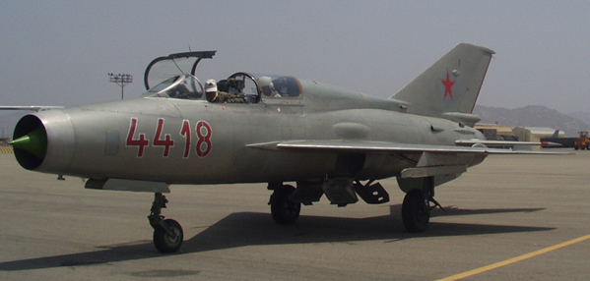
What could fail in a major EMP Event?
(Continued)
We found that a captured Russian aircraft (30 years ago) used vacuum tube technology “because vacuum tube technology was able to withstand a powerful electro-magnetic pulse (EMP), a side-effect from nuclear explosion. This radiation is harmless to humans but very damaging to modern solid state electronics”.

Slide 31
What Could Fail In A Major Event?
(Continued)
Banking and finical institutions may be unavailable and if information is not backed up some or all account information may be lost.
On the bright side some of your credit card balances may also be lost.
Those who have cash on hand will be fortunate but cash may have little value and we may revert to a barter system for a while.

Slide 32
What Could Fail In A Major Event?
(Continued)
Many amateur radio repeaters may have failed.
Our unprotected base, mobile Radios may have failed.
Communication will be critical and ham operators with working stations will be highly valued.
If it were just a single portion of the world that is effected like the US and Canada we would be highly vulnerable to aggressive countries

Slide 33
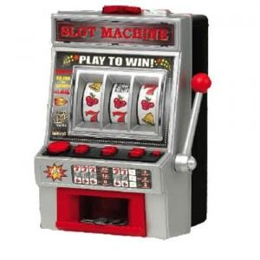
What Are The Odds This Can Happen?
The threat is real and an EMP event can happen, especially a MCE that we have no control over.
We are at high risk because we are so dependent on our electrical based world today.
Ignoring the possibility may not
be a good bet.

Slide 34
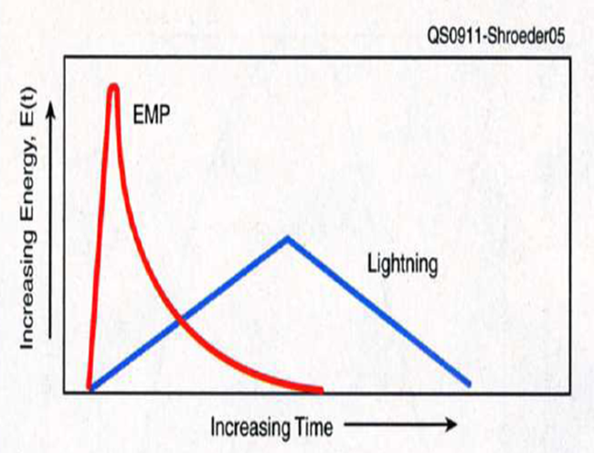
What is an EMP or CME Event?
EMP (man made or solar) capable of traveling thousands of miles and damaging or disrupting sensitive electronics and electrical systems.
A couple of high altitude detonations could disable communications, defense systems and electrical infrastructure without incurring a single loss of life.

Slide 35
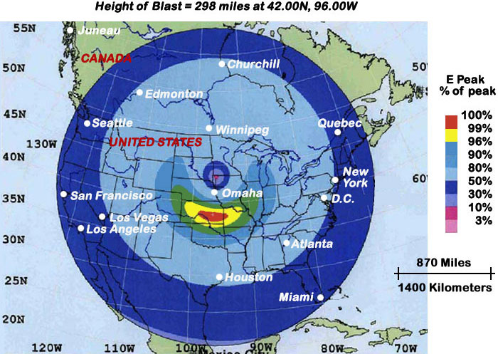
EMP Affected Region For A Nuclear Detonation

Slide 36
How Much Energy Are We Talking About?
Electric field strengths of up to 50 KV per meter.
Magnetic field strengths of up top 120 amperes per meter.
Exposed wiring will simply burn up with voltages and currents this high.
The rise time of these events will be from a few
nanoseconds to tens of seconds or longer.

Slide 37
The CME or EMP Event
Large currents are conducted into electronic devices through:
  Antennas
  The power grid
  Communication lines
  Data lines
  Circuits will “ring” at their input resonant frequency
Upper atmosphere ionization means:
  Higher noise in HF signal paths
  Increase or decrease of D layer reflectivity

Slide 38
Comparison Of A CME And EMP Event
An MCE event surge can eliminate electrical power for a long time, maybe years.
Nothing powered by our power grid will work.
All line powered devices will be at risk.
An EMP radiation flash will create, in nanoseconds, high voltages and currents in even short wires, more in long/large antennas tuned to less than 100 MHz such as Yagis and dipoles.
Unprotected equipment may be destroyed

Slide 39
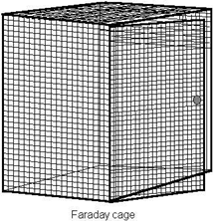
Protecting Against MCE and EMP
The problem is real
In order to design equipment and a communications station to withstand EMP (Harden it) will be costly.
Store back up equipment disconnected and in
a “Faraday Shield” or other Metal enclosure.
Disconnect any radio when not in use (antenna, power Supply, external microphones, data/computer lines, external modems and interfaces).
VHF and UHF radios for line of site communication with small antennas (rubber ducky's) will likely survive

Slide 40
Amateur Radio in Disaster Recovery
Amateur Radio incurs the obligation and responsibility to be ready and to provide vital communications during all emergencies including EMP and CME events.

Slide 41
Amateur Radio in Disaster Recovery
A FEMA Administrator Described the Amateur Radio operator as the ultimate comunications backup.
Disaster response personnel, because of the resiliency in all other systems, may tend to dismiss the amateur radio role as ultimate backup with their “my system can’t fail mentality”.
Remember when other communications systems fail Amateur Radio will be there.

Slide 42

Have You Given Up Hope?
Take steps to insure you have communication capability after the event.
Protect your sensitive electronics
Consider having Backup solar or wind
power to charge your radio batteries.
A few watts on HF may get out quite well since many other man made noise sources may no longer be there.

Slide 43
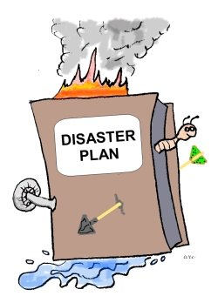
When All Else Fails
An EMP or MCE event could cause massive social disorder, starvation and disease.
Strong local social networks such as CERT, community, church groups, etc. will promote survival.
Man made and solar EMP can destroy communications equipment radio amateurs
rely on. Communications readiness will be
extremely valuable and communicators valued.
Your equipment must be protected.

Slide 44
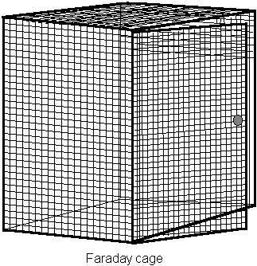
EMP Protection-The Faraday Shield
A “Faraday Shield” can protect radio and electrical equipment.
A “Faraday Shield” is enough metal around an object keep radio frequency out. It can be solid or mesh material.
Aluminum foil wrapping works, a galvanized trash can, ammo can or file cabinet will work as well.
A ground lead on the shield can act as an antenna.

Slide 45
Wrap Radios In Foil And Place In Bags
Choose the radios and gear to be protected. Consider HT’s, small mobiles, accessories and a portable short wave receiver.
Wrap in aluminum foil. Be sure to seal joints by folding.
Place wrapped items in plastic bags, insulated from each other.
Place gear in a metal container with a lid.

Slide 46
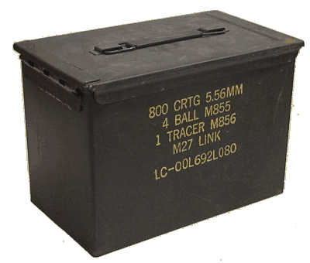
An Ammo Case Faraday Shield
An Ammo case can provide
electrical as well as
environmental protection
for you sensitive
electronics.
Other metal storage
containers like a metal file cabinet,
or galvanized trash can (with a tight metal lid) for larger items.

Slide 47
Using The Ammo Case
Install insulation/padding material on the inside.
The ammo box can hold a lot of your gear

Slide 48
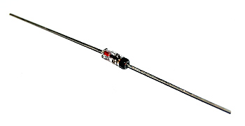
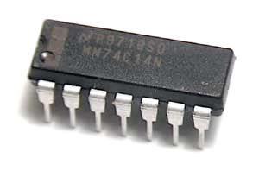
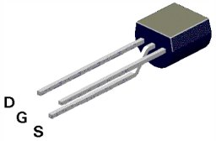
EMP And Vacuum Tube Gear
An EMP flash will fry any un-protected solid state equipment because solid devices are so sensitive.
Vacuum tubes are generally unaffected.
Vacuum tube transmitters and receivers are substantially unaffected but receivers may loose may loose front end coils and components.
Anything with a power cord is at risk

Slide 49
Dig Out That Old Heathkit
Vacuum tube amateur radio receivers and transmitters will likely survive EMP, as long as there are no leads connected.
Keeping spare parts for Vacuum tube receiver front ends etc. would be prudent.
Powering vacuum tube equipment will quickly drain batteries (you will need and inverter for 115V power).
Solar power will keep them going.

Slide 50
EMP And Lightning Protection
Grounding protects against lightning but acts like an antenna for EMP.
Lightning and electrical safety grounds are required for safety and often by law.
EMP protection must supplement but not defeat lightning or electrical protections.
Most lightning damage comes from power line surges, therefore EMP/MCE protections are similar to lightning protection.

Slide 51
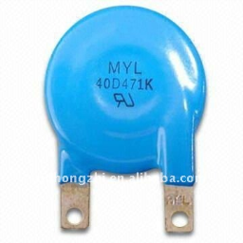
EMP Antenna Protection
E1 EMP is a nanosecond voltage pulse. Lightning arrestors will not stop it they are too slow (mili-seconds).
Metal oxide Varistor’s (MOV’s) with low clamping voltages and fast nano-second response time can prevent EMP pulse from getting into
the equipment. They need to be connected
across all inputs, antennas, power
supply leads, microphone leads, data
lines, etc.

Slide 52

EMP and VHF/UHF
An EMP Flash conveys little energy above 100 MHz.
Hand Held transceivers with rubber ducky antennas are at little risk (unless plugged into a charger).
UHF and VHF repeaters are unlikely to survive EMP effects with their line operated power supplies antennas and towers

Slide 53
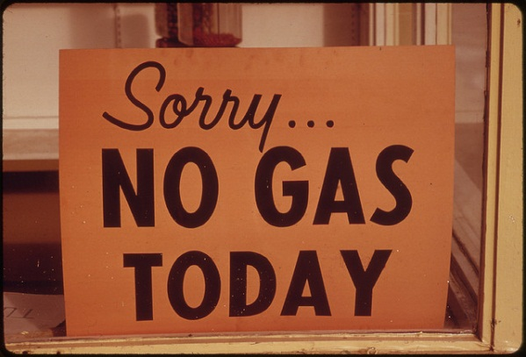
Post EMP/CME powering of radios
After an EMP/MCE event electrical power may be down for an extended period of time.
Communications will depend on emergency power.
Gasoline generators will run out of fuel, and soon none will be available.
Batteries with solar power
charging will keep you on
the air.

Slide 54
Solar Power in a CME/EMP event
EMP can fry solar panels, but a wire mesh “Faraday shield” can protect them (but will cost efficiency). The leads also need to be protected with shielding and MOV’s.
An MCE surge will likely destroy solar systems connected to the power grid.
A solar power system kept in a “Faraday shield” and deployed after the event is the best emergency power source.

Slide 55
EMP/CME and batteries
Rechargeable batteries will provide emergency power for communications.
Solar power can recharge batteries as can other sources of electricity.
Batteries can be protected in “Faraday shields” as well. Be sure the terminals are insulated from the “Faraday shield”.
Batteries connected to a charger at the time of an EMP/MCE event may be at risk.

Slide 56
EMP / CME & Disaster Preparedness
Strengthen local social networks (Community,
CERT and Church groups)
Community enables survival.
Foster family survival with stored water, food, medicine and weapons (in other words be prepared).
Store unused equipment and back-up solar power system in faraday cages (batteries separately)
Protect all antennas with MOV’s and all power supplies with isolated UPS’s (Uninterruptable Power Supplies) and MOV’s.

Slide 57
Who Will You Talk To?
Your gear is protected but:
Talk with your ham radio friends and get them to prepare also.
Use your extra gear for this project.
Rotate batteries & recharge on an appropriate schedule.
Stage kits at various sites
Mark kits for easy identification and location.
Don’t forget to test items in the kits periodically.

Slide 58
Further information and investigation
A good single source regarding EMP and Radio is Jerry Emanuelson at http://www.futurescience.com/emp.html
QST archive articles: (Available online for free to ARRL members)
  August 1981, August 1986, September 1986, October 1986, November 1986 & November 2009
June 2012 National Geographic Magazine

Slide 59
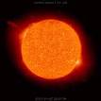
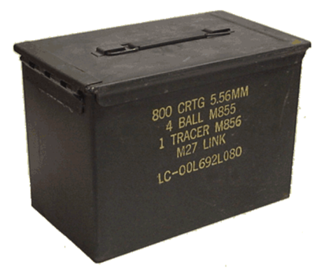
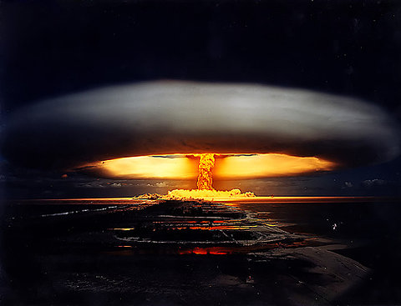
THE END (Maybe not)
Any questions?

Slide 60
Rules For Use and Disclaimers
This presentation may be used for any reasonable non commercial purpose in furtherance of amateur radio and public safety as long as authorship is acknowledged (see slide 2 ) and this final slide is included.
Presenters may not charge for teaching and delivering this presentation.
This presentation may not be placed on any public web site.
Author is not responsible for any errors contained in this presentation.
This is not a definitive analysis of required protection for your gear. Please do your own additional research and reach your own conclusions as to what is required in your situation to protect your gear.
The author of this presentation can be reached at ad7fo@arrl.net

Slide 61
References Used
EMP Presentation by Bart Lee K6VK For Pacificon 2011
“Nuclear Weapons effects on communication systems” article by Robert Hendrickson AG3U in QST August 1981.
“Electromagnetic Pulse and its Implications for Emcomm” by H. Robert "Bob" Schroeder, N2HX, in the November 2009 issue of QST
National Geographic, June 2012 article on “Solar Supper Storms”.
Dennis Bodson’s, W4PWF, four part article series: in QST (Available online for free to ARRL members) August, Sept., Oct., and Nov. 1986.
The Internet.

Slide 62
Author
John (Jack) Tiley AD7F0
ad7fo@arrl.net
ARRL Certified Emcomm Instructor
ARRL Technical Specialist and Coordinator
ARRL Technician, General and Extra License Class Instructor
ARRL VEC
Retired Electrical Engineer

